Slide 1
Artificial Instructor
Shawn Huntzberry
Notes:
DONE BY ~(1 - 1.5) Minute Mark
Hello ladies and gentlemen, I hope everyone is enjoying the amazing projects we have seen tonight, I know I have. Hopefully I can continue the good trend as I present the latest developments with my application, The Artificial Instructor.
Before I go into details about my program I would like to get an idea of who is in attendance tonight. So by a show of hands…
Who here plays an instrument, or is currently learning to play an instrument?
Now, who here, that doesn’t play an instrument, wishes they would have learned an instrument?
Open up with questions:
By raise of hand….
Who plays a musical instrument?
Who has taught themselves a musical instrument?
Who wishes they knew an instrument?
Who would be willing to try to learn if there was a way to learn without making any sacrifices in their daily lives?

Slide 2
background
People in the US(2010):
~305 Million
*US Census Bureau*
People who play an instrument in the US(2010):
~18.8 Million
*statista*
Money($) generated by Music Industry (US - 2012):
~15.06 Billion
*statista*
Money($) generated by Music Industry (Global - 2012):
~47.4 Billion
*statista*
Notes:
DONE BY ~(2 - 2.5) Minute Mark
Works Cited:
People in the US: US Census
People who play an instrument/money generated: Statista http://www.statista.com/topics/1639/music/
http://www.npr.org/sections/ed/2014/09/10/343681493/this-is-your-brain-this-is-your-brain-on-music

Slide 3
Current problems with the Market
How do we Solve these Problems?
Self-Learning
Instructors
Available to the user at anytime
Encourages users to keep trying
Personal to each user
Less Structure
Less Motivation
Hard to gauge skill progress
No feedback
Expensive
Time Constraints
Transport Equipment
Frustrating or Embarrassing
Affordable for all types of users
Gives Meaningful Feedback
Structured learning process
Notes:
DONE BY ~(3 - 3.5) MINUTE MARK

Slide 4
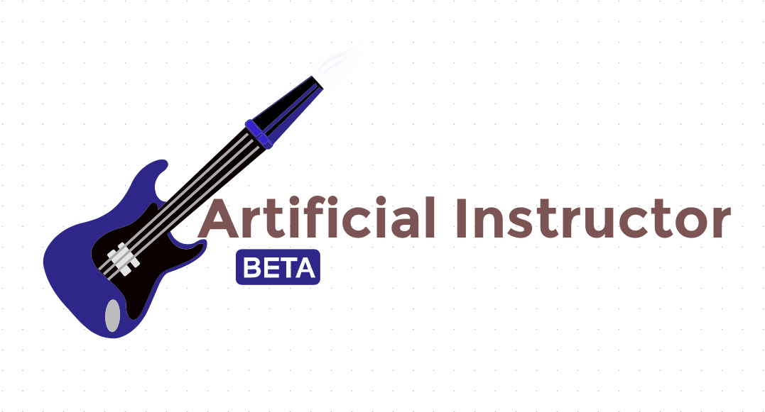
THE ARTIFICIAL INSTRUCTOR
Makes learning the Bass Guitar:
Accessible
Accurate
User-Friendly
Expandable
Notes:
DONE BY ~(4 - 4.5) Minute Mark
What it is?
-program to test exercises
-gives feedback on attempts
-scores users to move to more advanced stuff

Slide 5
Accessible
Less Equipment required, all equipment supported!
Using JavaSound API, the system automatically sets the audio input using DataLines and Mixers
plug in and go
Lessons can be started/stopped at any time
No reservations or appointments required
Notes:
DONE BY ~(5 - 5.5) Minute Mark

Slide 6
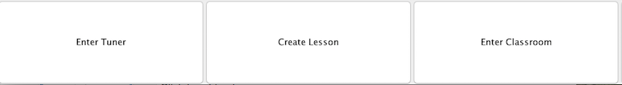
User-Friendly
Simple Navigation
No configuration required
Lessons are easy to interpret.
Only three components, but thousands of different uses

Slide 7
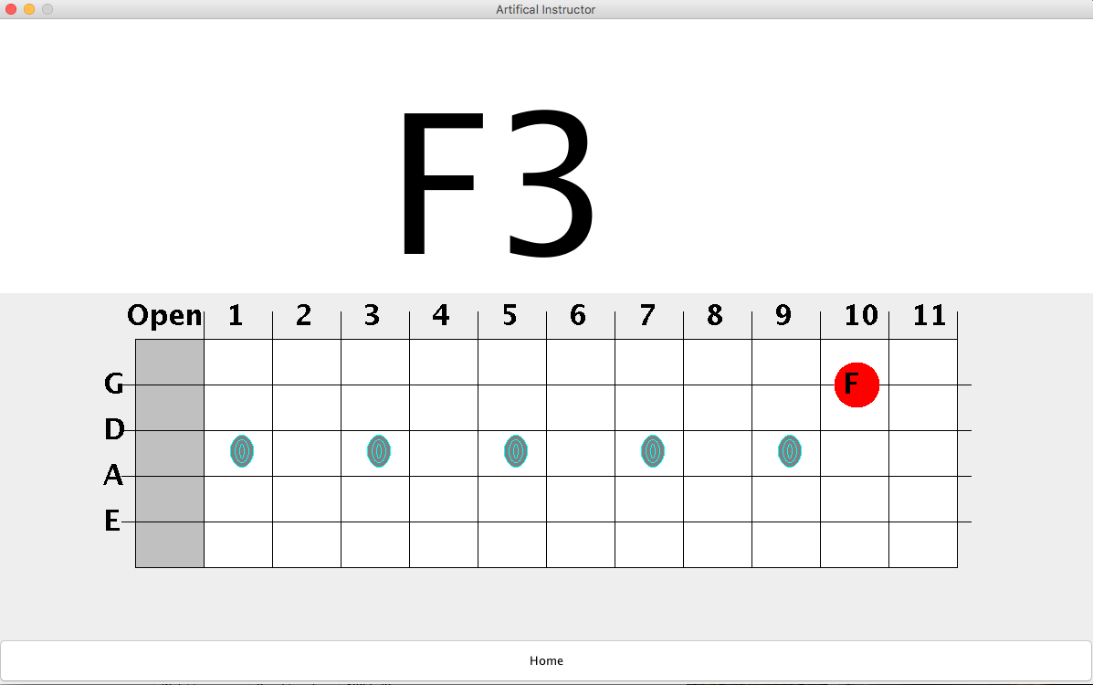
The Tuner

Slide 8
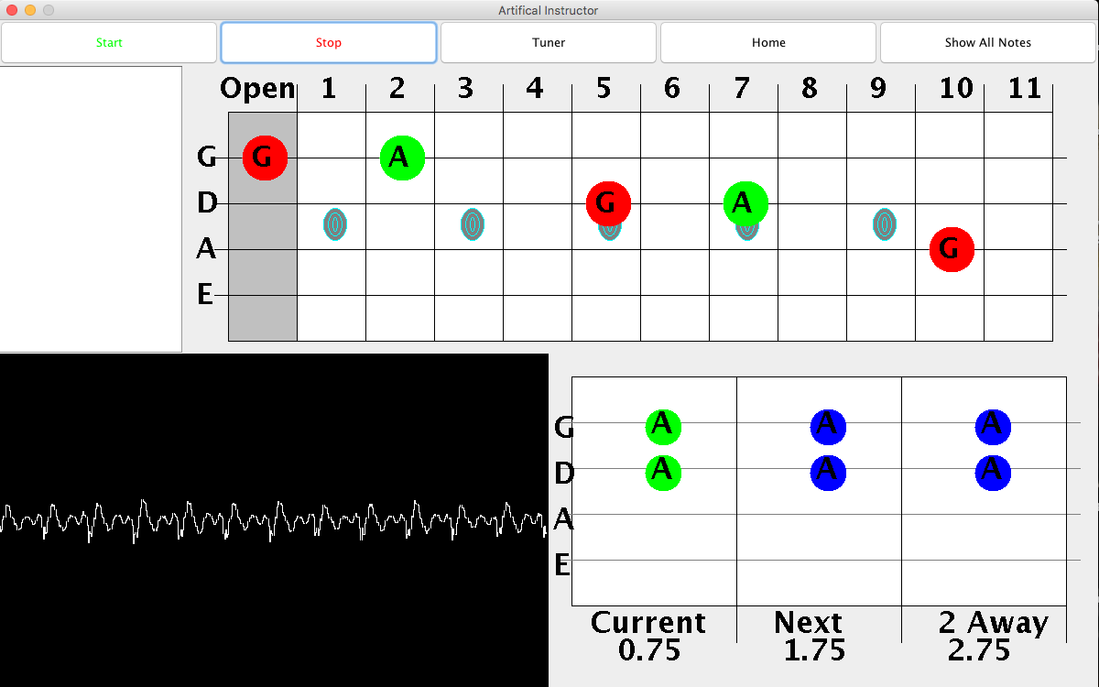
Lesson Screen
Notes:
DONE BY ~(7 - 7.5) Minute Mark
GREEN - Note is about to change
RED - User input
BLUE - Not should be strummed or be ringing out
PROMPT box in corner -- display any errors

Slide 9
Expandable
Lessons programmed using JSON format
All lessons get feedback from system, even custom lessons
Multiple Uses:
Record Songs
Practice Lessons
Freeplay
Tuner

Slide 10
DeMO:
Lesson Creation
Notes:
DONE BY ~(7.5 - 8) Minute mark

Slide 11
Accurate
Needs to detect notes as you play to give proper feedback
Pitch Detection using YIN_FFT algorithm
Using TarsoDSP pitch processor structure to detect frequency
Frequency translated using conditionals (Hz → Oct/Val)
Octaves 0-4 supported
“Sound”(input) → Frequency(TarsoDSP) → Note & Octave Value(AI method).

Slide 12
Demo:
Attempting a Lesson
Notes:
DONE BY (6 - 6.5) Minute Mark

Slide 13
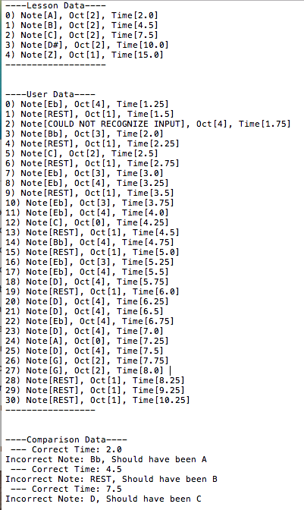
FeedBack File
Lesson Data
User Data
Comparison Data
Notes:
DONE BY (6 - 6.5) Minute Mark

Slide 14
Works Cited:
Information:
-Slide 2:
“People in the US”
URL:http://www.census.gov/2010census/data/
“People that play an instrument”
URL:http://www.statista.com/statistics/192834/people-playing-a-musical-instrument-in-the-us/
“Money in the US” + “Money Globaly”
URL:http://www.statista.com/topics/1639/music/

